Slide 1
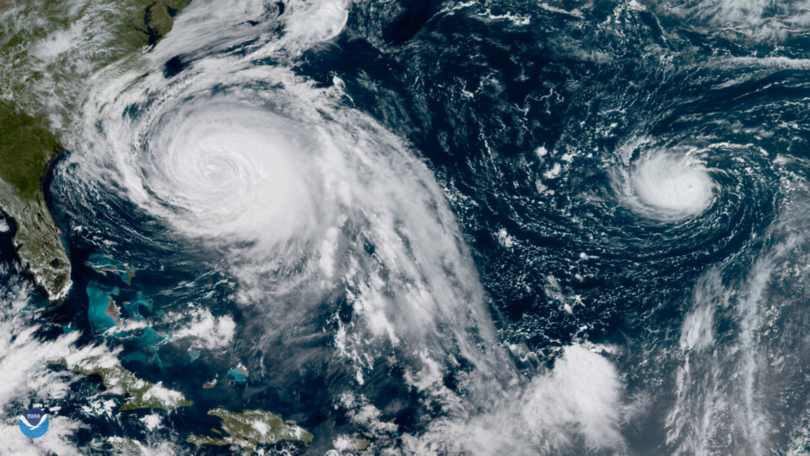

AMERICAN
RED CROSS
DEADLY & DAMAGING
STORM EVENTS
Group 5: Ankur Bhattacharjee, Bimala Joshi, Cezane Karki, Isabella Pham, Kiran Kuchekar, Shivangi Vipulbhai Borad

Slide 2
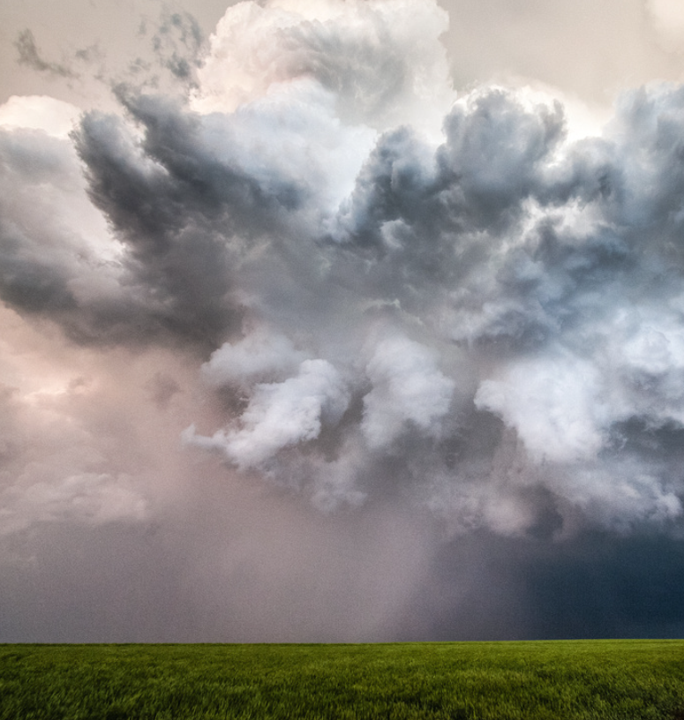
TABLE OF CONTENTS
01
03
04
02
ABOUT US
OUR PROCESS
Who is the American Red Cross, and what do they do?
Overview of the project’s workflow
THE TASK
NEXT STEPS
Data-driven, actionable recommendations
Gather data to assist disaster relief efforts

Slide 3
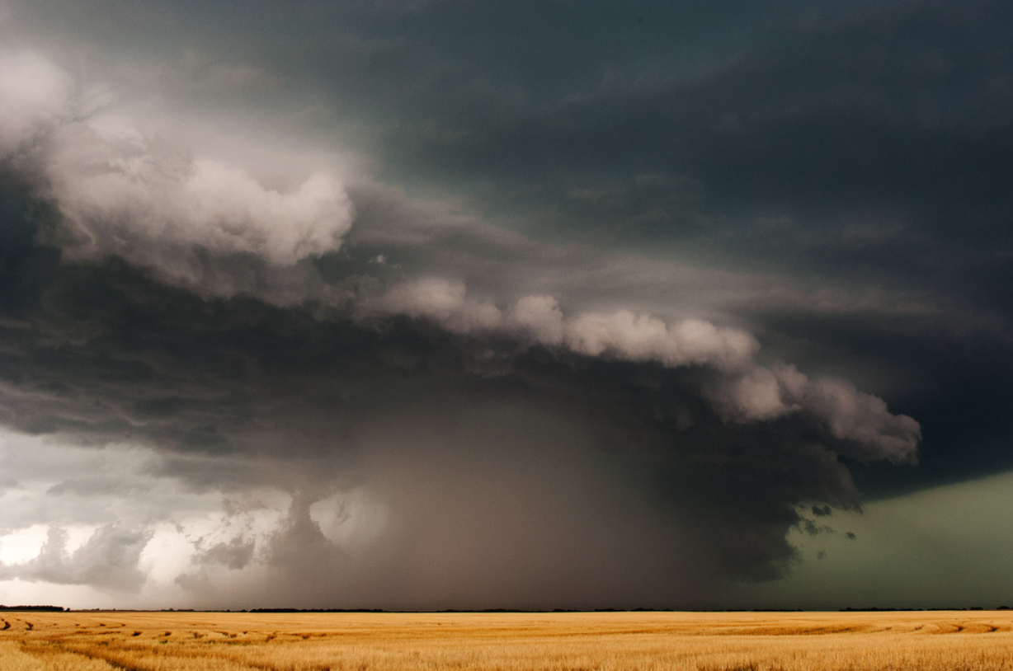
ABOUT THE
RED CROSS
01
What is our non-profit, and what do they do?

Slide 4
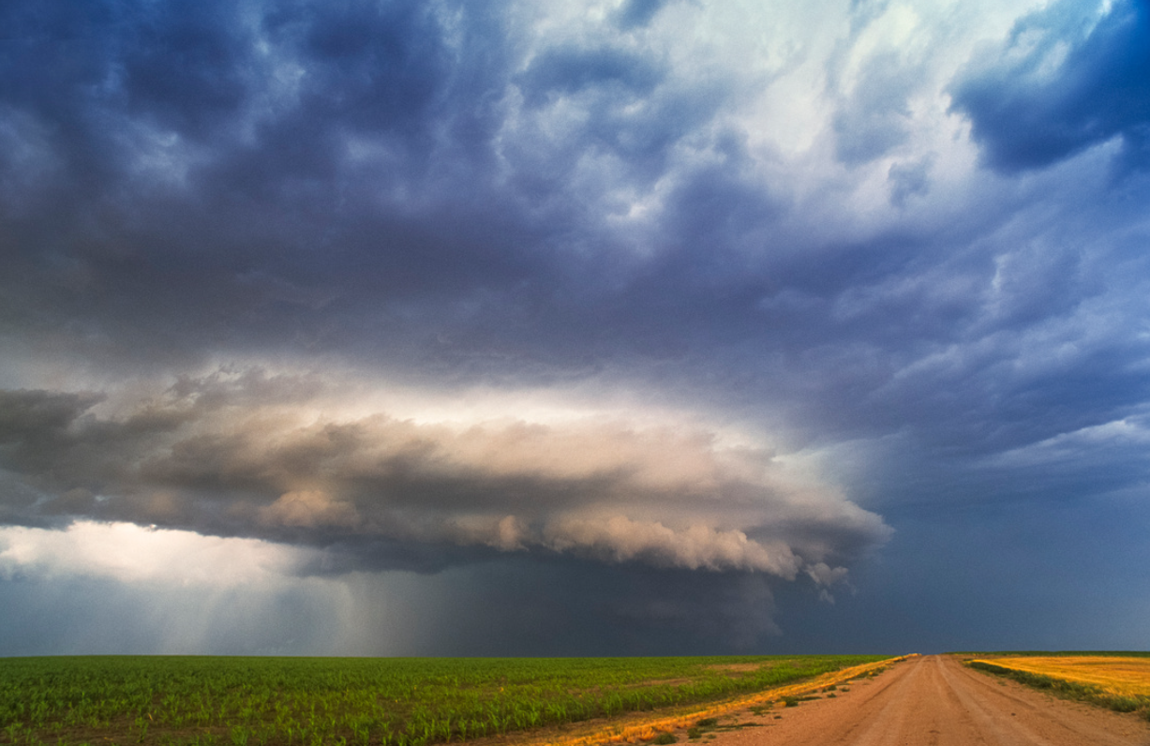
ABOUT THE RED CROSS
MISSION STATEMENT
WHAT IS IT?
DISASTER RELIEF
“The American Red Cross prevents and alleviates human suffering in the face of emergencies by mobilizing the power of volunteers and the generosity of donors.”
(American Red Cross, n.d.)
Non-profit organization
Largely volunteer-based
Supports communities worldwide
Provides:
Training courses for emergency care
Financial & emergency communications support to military families
Responds to a wide variety of emergencies, such as:
Wildfires
Tornados
Hurricanes
Aid is adapted to the unique needs of each community
Aims to provide immediate response services and long-term relief
Notes:
ABOUT THE RED CROSS
According to their mission statement, the Red Cross aims to alleviate suffering during emergencies
They are a non-profit organization which relies largely on volunteers to provide aid
95% of all disaster relief workers are volunteers
Apart from domestic service, red cross also provides international emergency support.
Beyond immediate response services, the Red Cross also:
Offers training programs, such as CPR, first aid, and basic life support (also known as BLS)
Red cross provides emergency communication support and financial aid assistance to military families.
DISASTER RELIEF
The Red Cross responds to an emergency every 8 minutes. Emergencies range from the average house fire to natural disasters, such as wildfires, tornadoes, and hurricanes
The resources and aid provided by the Red Cross is always adapted to suit the unique needs of the community and disaster at hand, and they consistently aim to provide both immediate response aid - such as evacuation services and emergency supply distribution- and long-term relief in the form of community-wide grants and financial aid given to individual families.

Slide 5
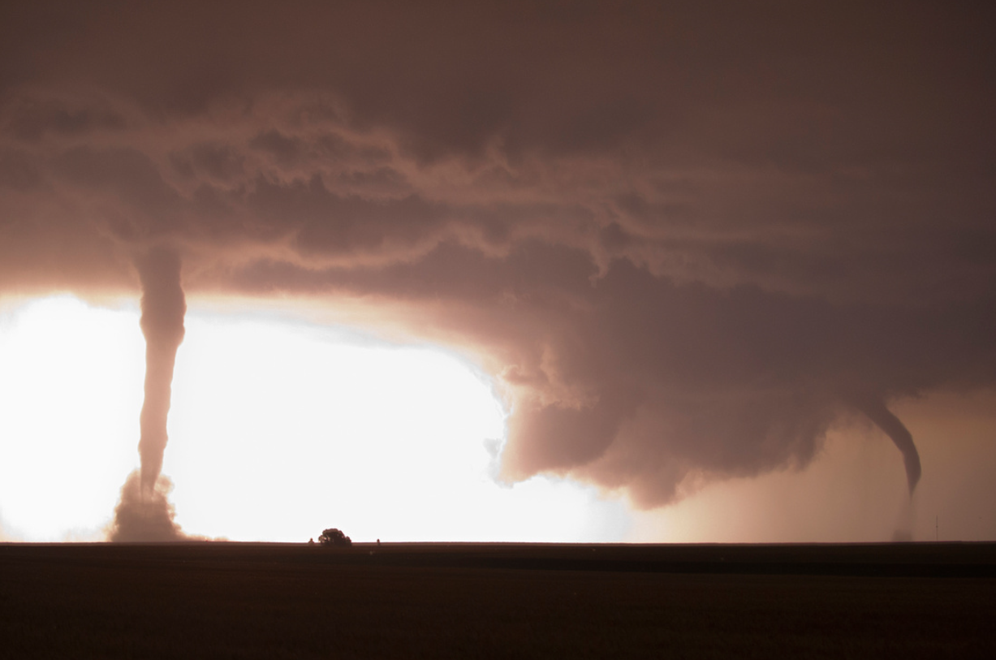
THE TASK
02
What have we been asked to do, and why?

Slide 6
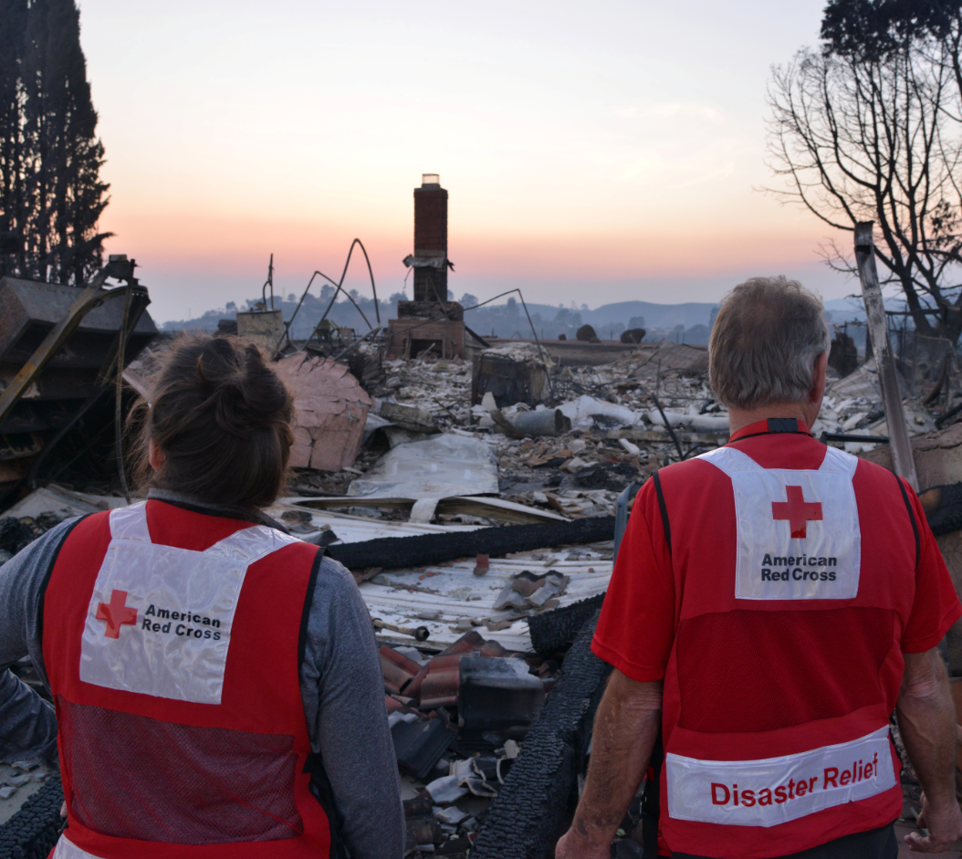
THE CURRENT
SITUATION
The Red Cross needs to determine which regions in the U.S. are most prone to storm events so it can allocate the appropriate costs, labor, and resources to prepare for future events.

Slide 7
TACKLING THE PROBLEM
01
02
03
MAIN GOALS
PROCESS
Identify data sources
Create a data pipeline for future automation & analysis
Develop a model for predicting disaster zones & storm events
COLLECT
REFINE
STORE
Identify two high-quality data sources pertaining to storm events and their after effects
Transform and organize data for optimal future analysis by data scientists & analysts
Preserve data for future use and assign the appropriate access permissions

Slide 8
OUR
PROCESS
03
How did we tackle the problem?

Slide 9
DATA GENERATION & COLLECTION
GENERATION
COLLECTION
Data Sources
Static: National Oceanic and Atmospheric Administration (NOAA) Storm Events Database
Format: Structured
Availability: Historical(1950-2024) & Public
Dataset Size: 2.9 million records, 50 features
Streaming: National Weather Service (NWS) API
Format: Semi-Structured
Availability: Live & Public
Dataset Size: 500 records, 19 features
The Beginning of the Data Lifecycle
Key Sources of Storm Events Data
Weather Sensors
Radars
Historical Databases
Various other IoT Devices

Slide 10
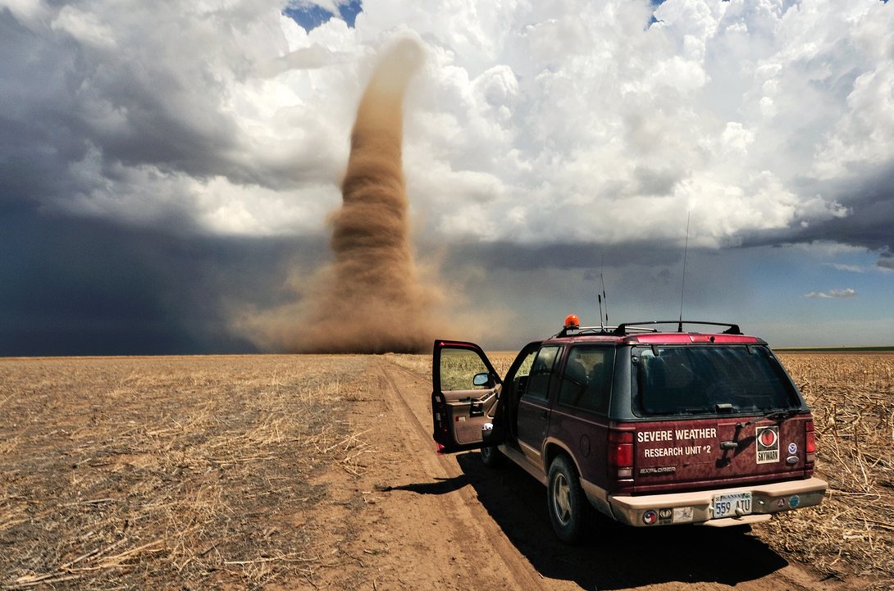
DATA PROCESSING
OPENREFINE
Prioritize high-quality data to avoid ‘garbage in, garbage out’ issues
Data Cleaning
Handle missing value
Standardize data formats
Data Wrangling
Create new calculated fields
Reshape data
Refined Dataset
Static: 1 million records, 28 features
Streaming: 2000 records, 19 features

Slide 11
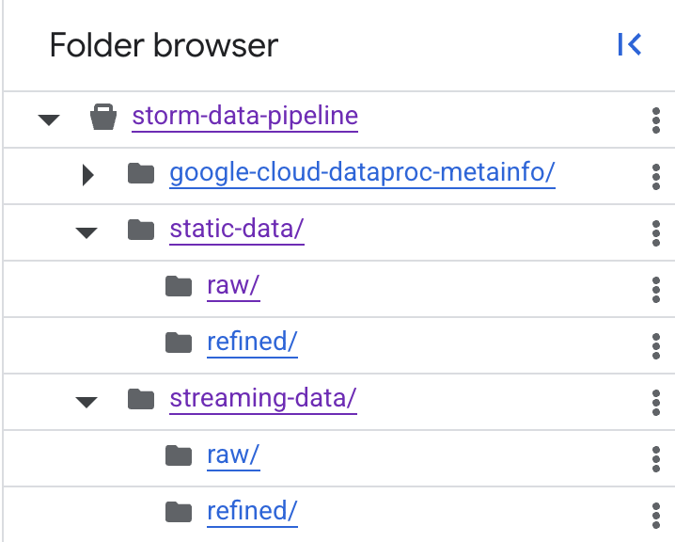
DATA STORAGE & MANAGEMENT
STORAGE
MANAGEMENT
Used GCP buckets
Assigned Permissions:
Editor
IAP access for tunneling and server access
Usefulness of GCP:
Scalable infrastructure
Enhanced cloud security
Simple and Flexible management of permissions

Slide 12
DATA ANALYSIS
Tools Used: BigQuery, Apache Spark & Hive
Usefulness of queried data to data scientists and analysts:
Trend Analysis
Predictive Modeling and optimization
Data Quality Checking
Descriptive Reporting (Dashboard)
Analysis of Data:
Damage caused each year by storm
Most affected area/state
Damages in past vs current
Types of severity alerts in different areas/states.
GCP DATAPROC
Work done in Dataproc:
Queried large scale of data
Used spark and hive for time comparison
Usefulness of Dataproc:
Improve query performance
Large scale data processing/ analysis
Sufficient storage and faster access

Slide 13
DATA ANALYSIS: HIVE VS SPARK
Query # | STATIC DATASET
 | Apache Hive | Apache Spark
1 | 24.554 seconds | 23.685 seconds
2 | 17.004 seconds | 26.389 seconds
3 | 18.463 seconds | 18.170 seconds
4 | 17.229 seconds | 8.502 seconds
5 | 18.571 seconds | 9.264 seconds
6 | 22.495 seconds | 9.671 seconds
Average Total Time | 19.72 seconds | 15.95 seconds
Query # | STREAMING DATASET
 | Apache Hive | Apache Spark
1 | 7.005 seconds | 8.952 seconds
2 | 8.133 seconds | 8.673 seconds
3 | 8.094 seconds | 2.248 seconds
4 | 7.868 seconds | 7.775 seconds
5 | 7.128 seconds | 5.788 seconds
6 | 7.005 seconds | 8.952 seconds
Average Total Time | 7.65 seconds | 6.69 seconds

Slide 14
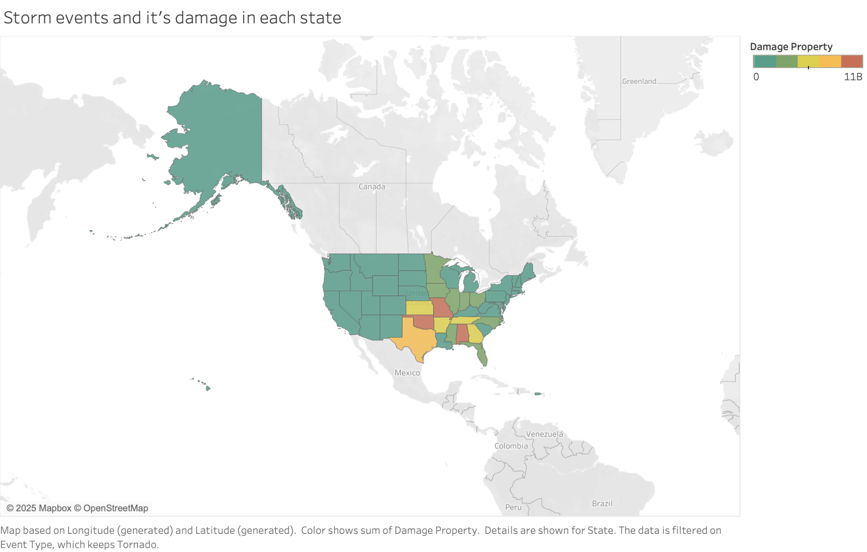
DATA VISUALIZATION & INTERPRETATION
Storm events are most concentrated around the South/Midwest
Most affected states include:
Of the affected states:
Financial aid would be best allocated:
Storm Events by Estimated Property Damage (in USD)
Oklahoma
Missouri
Alabama
Arkansas
Kansas
Georgia
Tennessee
Texas
Oklahoma, Kansas, & Tennessee are the most storm-prepared based on energy infrastructure (Cohn, 2023)
Georgia has the highest median housing value (U.S. Census Bureau, 2023)
To Georgia based on housing costs
To Missouri and Alabama based on need/damage amounts
BONUS

Slide 15
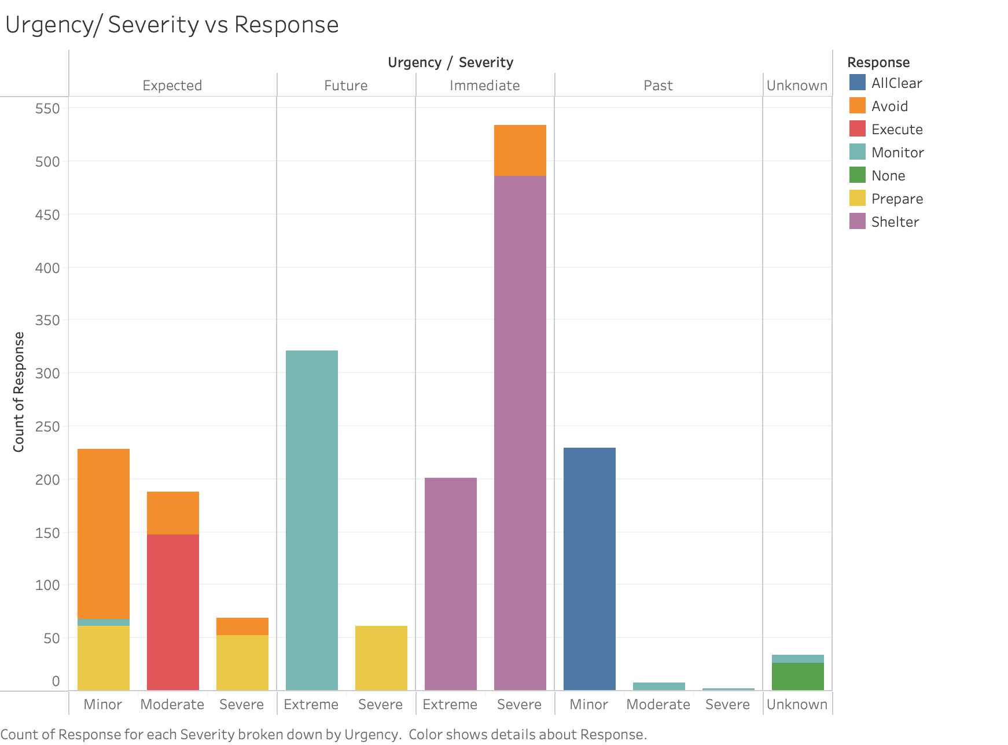
DATA VISUALIZATION & INTERPRETATION
VARIABLES
Urgency: Immediacy of a storm (i.e. how soon it is expected to arrive in a given area)
Severity: Danger level of a storm
Response: Type of alert broadcasted, based on Urgency and Severity
RECOMMENDATIONS
Storms with Expected urgency and Moderate severity:
Aid should focus on evacuation and community safety plan execution
Storms with Expected urgency and Severe severity:
Aid should focus on evacuation and shelter preparation
Storms with Future urgency and Severe severity:
Aid should focus on shelter preparation
BONUS
Notes:
This bar chart illustrates the weather alert broadcasted by the National Weather Service in response to storm Urgency and Severity notifications received by the NWS.
Upon receiving Urgency and Severity data, the weather API broadcasts a different type of alert (i.e. response), such as “All Clear”, “Avoid”, or “Shelter”.
The Red Cross is advised to act as quickly as possible upon receiving an “Expected” or “Future” urgency broadcast, and - assuming that

Slide 16
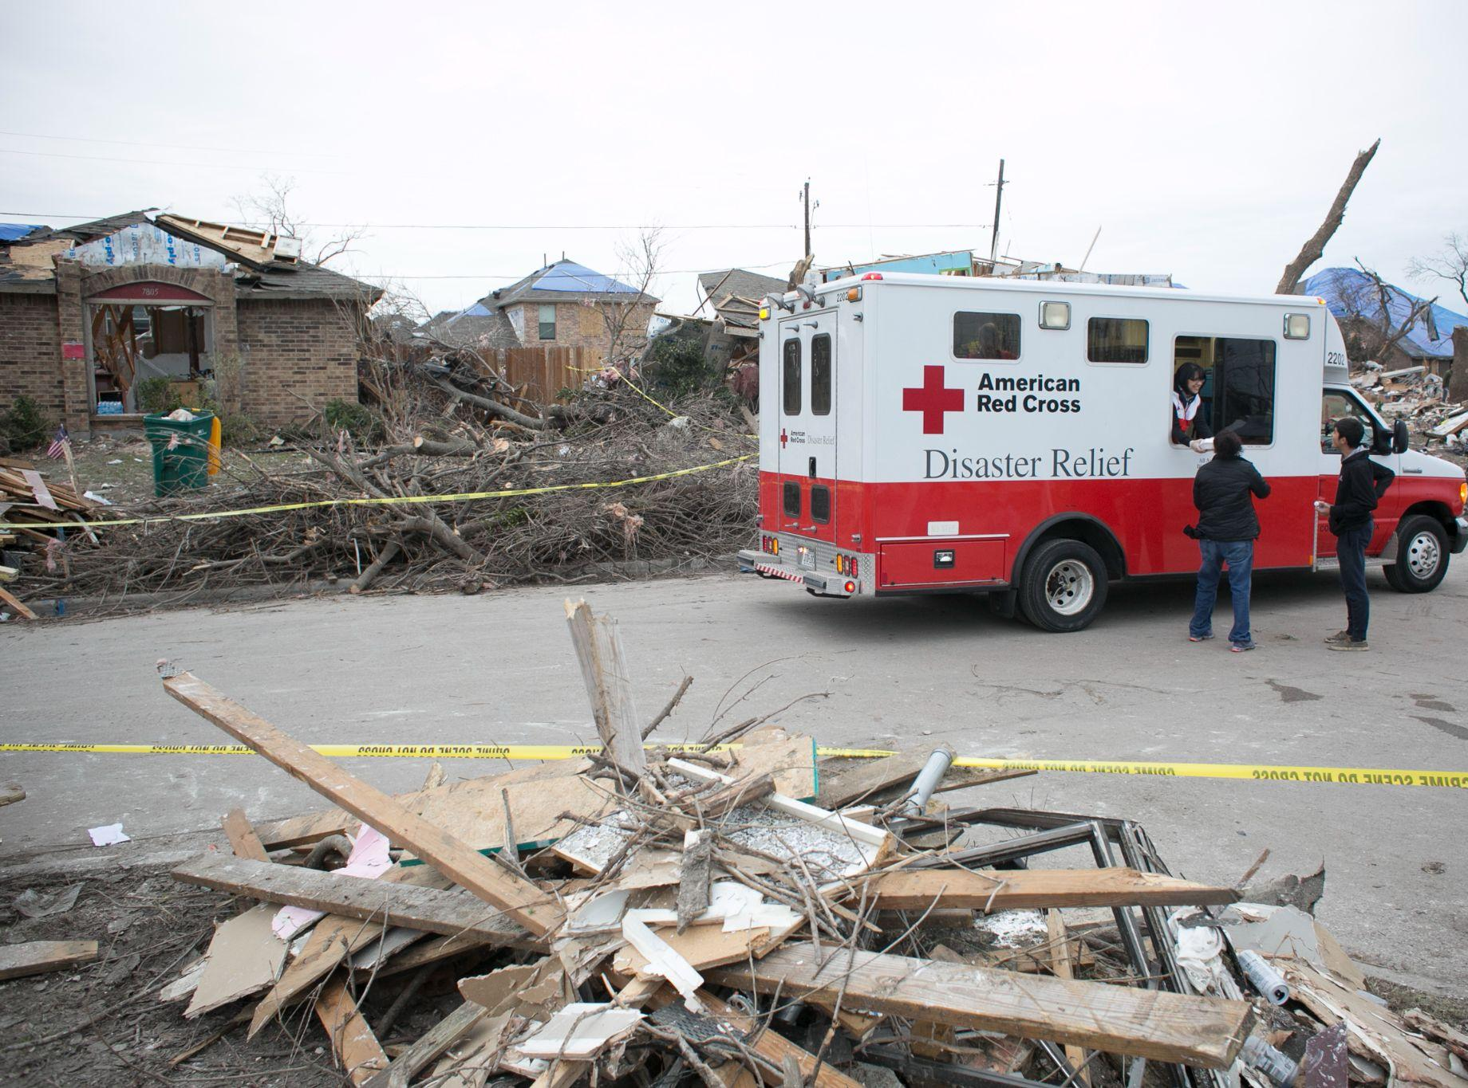
NEXT STEPS
04
How do we act on the data?

Slide 17

RECOMMENDATIONS
01
03
02
04
Forecasting storm effects using predictive modeling
Real-time, automated
alert systems
Geospatial risk mapping for resource deployment
Optimization of public
messaging & communication

Slide 18
PROJECT OVERVIEW
Full Data Life Cycle: Collected, processed, stored, and analyzed storm data.
Historical + Live Data: Combined 1950–2024 records with live 2025 data.
Tools Used: OpenRefine, Spark, Hive, BigQuery for processing and analysis.
Trends Found: Storm types, urgency levels, and response patterns.
Alert Classification: Sorted by severity and geography to find risk areas.
Text Analysis: Word frequency and sentiment from alerts via Spark & Hive.
Challenges: Missing cyclone data, OpenRefine
CONCLUSION
Clear Visuals: Summarized complex storm data for better communication.
Spark vs Hive: Spark processed data faster, ideal for real-time alerts.
Project Impact: Built a predictive, user-friendly system for disaster response

Slide 19
REFERENCES
American Red Cross. (n.d.). Mission & Values. Retrieved April 22, 2025, from https://www.redcross.org/about-us/who-we-are/mission-and-values.html
American Red Cross. (2019). Red Cross Workers & Rubble (HCA Healthcare teams up with the American Red Cross) [Photograph]. HCA Healthcare. https://hcahealthcaretoday.com/2019/09/24/building-stronger-communities-hca-healthcare-teams-up-with-the-american-red-cross/
Cohn, S. (2023, July 28). These are the 10 American states that are the most prepared for extreme weather. CNBC. https://www.cnbc.com/2023/07/28/these-are-the-10-states-that-are-the-most-prepared-for-extreme-weather.html
Drenner, D. (2016). January: Tornadoes swept through Texas [Photograph]. https://redcrosschat.org/2016/12/27/disasters-of-2016-in-photos/
NOAA. (n.d.). Forecasts and Service: About the NWS [Government]. NOAA’s National Weather Service. Retrieved April 22, 2025, from https://www.weather.gov/about/forecastsandservice
NOAA Satellites. (2017). Hurricanes Maria and Lee in the Atlantic Ocean [Photo]. https://www.flickr.com/photos/noaasatellites/36721671963/

Slide 20
REFERENCES
Reed, J. (n.d.-a). Professional Storm Chasers Monitor Tornado (Storm Chasers) [Photograph]. Jim Reed - Extreme Weather. Retrieved April 28, 2025, from https://www.jimreedphoto.com/p222831751/h73E529EB
Reed, J. (n.d.-b). Supercell Approaching Rural Road (Storms) [Photograph]. Jim Reed - Extreme Weather. Retrieved April 27, 2025, from https://www.jimreedphoto.com/p469274228/h72FE2C61
Reed, J. (n.d.-c). Tornadic Supercell (Storms) [Photograph]. Jim Reed - Extreme Weather. Retrieved April 27, 2025, from https://www.jimreedphoto.com/p469274228/h22B7C5AB
Reed, J. (n.d.-d). Twin Night Tornadoes Illuminated by Lightning (Lightning) [Photograph]. Jim Reed - Extreme Weather. Retrieved April 27, 2025, from https://www.jimreedphoto.com/p283053052/h23871D41
Reed, J. (2005). Derecho (Storms) [Photograph]. Jim Reed - Extreme Weather. https://www.jimreedphoto.com/p469274228/h6EECD6C0

Slide 21
REFERENCES
Reed, J. (2011). Hurricane Irene Strikes New York (Hurricanes) [Photograph]. Jim Reed - Extreme Weather. https://www.jimreedphoto.com/p496431130/h794BCFF4
Shimizu. (2014, December 9). American Red Cross logo vector. BrandLogos. https://brandlogos.net/american-red-cross-25705.html
U.S. Census Bureau. (2023). Selected Housing Characteristics. U.S. Department of Commerce. https://data.census.gov/table/ACSDP1Y2023.DP04?q=DP04&g=040XX00US01,05,13,20,29,40,47,48

